Slide 1
Luxury Sales Housing Dashboard - Bangalore
End-to-End Data Analysis using SQL & Power BI
MYSQL|SQL|Power BI|DAX

Slide 2
BUSINESS PROBLEM STATEMENT
The Bangalore luxury housing market involves multiple builders, micros-markets, and buyer segments. Stakeholders lack a consolidated, data-driven view to understand.
Which builders generate the highest revenue
Which micro-markets show stronger demand
How bookings change across quarters
Buyer preferences based on possession status
Effectiveness of sales channels
This project aims to convert raw sales data into actionable business insights.

Slide 3
PROJECT OBJECTIVES
Analyze luxury housing sales performance in Bangalore
Identify top builders and high-performing micro-markets
Track booking trends across quarters
Understand buyer behaviour and configuration demand
Provide an interactive dashboard for decision-makers

Slide 4
DATA OVERVIEW
Source: Luxury Housing Sales Dataset
Granularity: One row per property booking
Key fields used:
Developer Name
Micro Market
Ticket Price (Cr)
Purchase Quarter
Buyer Type
Possession Status
Sales Channel
Amenity Score
SQL views were created to structure the data efficiently for reporting.

Slide 5
DATA CLEANING & MODELLING
Data Preparation & Modelling Approach
Removed null values from critical fields
Standardized quarter and year formats
Created SQL views for KPIs and analysis
Used fact level data for time based analysis
Designed visuals without unnecessary relationships to avoid aggregation issues
This ensured accurate, scalable, and refresh-safe reporting.

Slide 6
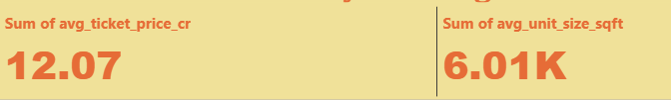


KPI OVERVIEW

Slide 7
Key Performance Indicators
Average Ticket Price: ₹12.07 Cr
Average Unit Size: ~6,000 Sqft
Total NRI Buyers: ~49.9K
These KPIs provide a quick snapshot of the overall luxury housing market.

Slide 8
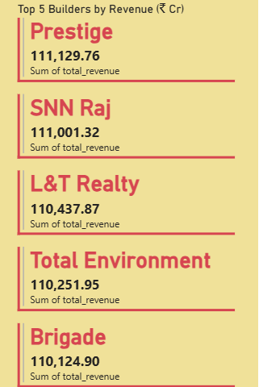
BUILDER PERFORMANCE ANALYSIS

Slide 9
Builder Performance Analysis
Prestige, SNN Raj, and L&T Realty lead in total revenue
Revenue distribution varies significantly across builders
Highlights market dominance and competitive positioning
This helps stakeholders focus on top-performing developers.

Slide 10
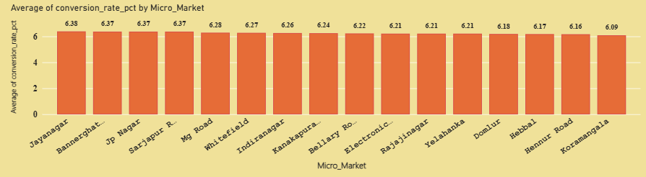
MICRO-MARKET PERFORMANCE

Slide 11
Micro-Market Conversion Analysis
Certain micro-markets show higher conversion rates
Demand concentration varies by locality
Helps identify high-potential investment zones

Slide 12
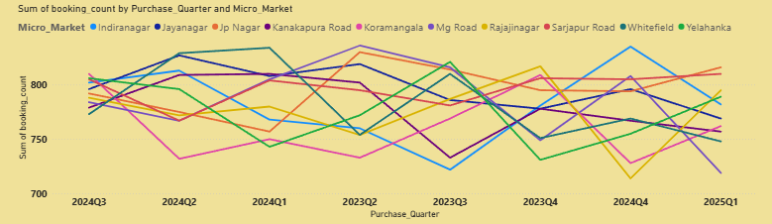
QUARTERLY BOOKING TRENDS

Slide 13
Quarter-wise Booking Trends
Booking volumes fluctuate across quarters
Seasonal patterns observed in demand
Some micro-markets show consistent booking growth
This insight supports sales forecasting and planning.

Slide 14
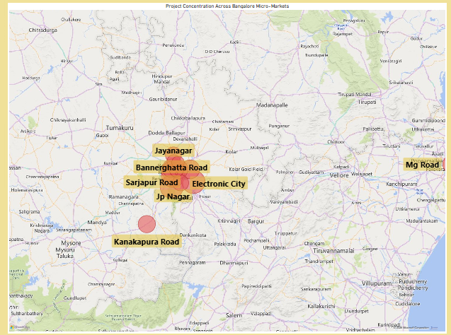
GEOGRAPHICAL DISTRIBUTION

Slide 15
Geographical Insights - Bangalore
Projects are concentrated in key micro-markets like:
Whitefield
Yelahanka
Electronic City
JP Nagar
Visual representation helps identify regional demand clusters

Slide 16
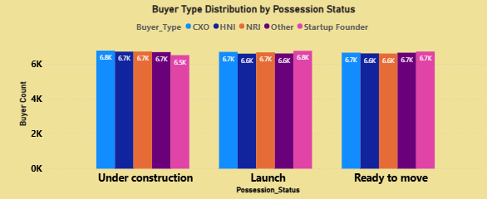
BUYER BEHAVIOUR ANALYSIS

Slide 17
Buyer Type & Possession Status Analysis
Ready-to-move properties show higher buyer interest
Buyer preferences vary based on possession stage
Helps builders align inventory with buyer expectations

Slide 18
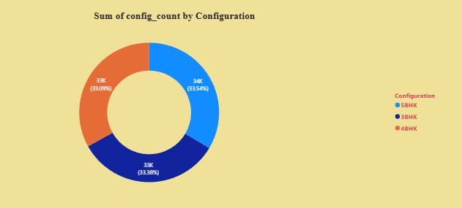
CONFIGURATION DEMAND

Slide 19
Configuration Demand Analysis
2BHK and 3BHK units dominate demand
Indicates preference for mid-sized luxury units
Useful for project planning and pricing strategies

Slide 20
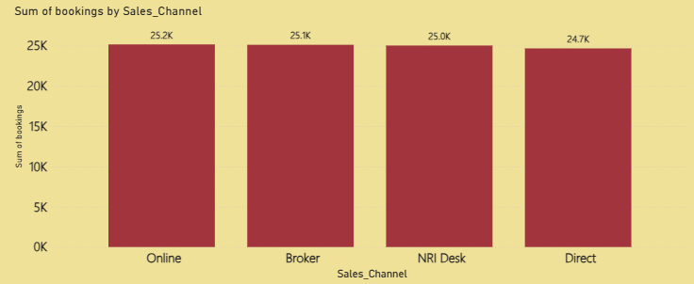
SALES CHANNEL PERFORMANCE

Slide 21
Sales Channel Contribution
Online, Broker, and Direct channels contribute significantly
Performance varies across channels
Helps optimize sales and marketing strategy

Slide 22
KEY INSIGHTS & BUSINESS IMPACT
Key Business Insights
Identified top builders and revenue leaders
Highlighted high-performing micro-markets
Revealed booking trends and buyer behaviour
Enabled data-driven decision making through interactive visuals

Slide 23
THANK YOU!

